Slide 1
Helping Your Child Grow Up Catholic
in today’s busy world
Notes:
These slides provide an outline for a facilitated conversation with parents about the importance of living faith in the household.
The real “content” of the gathering is both information (provided on the slides) and in the sharing among participants.
The role of the facilitator is to be prepared with examples, stories, and to coach the parents so they will recognize and be encouraged to accept their role in the faith development of their children.
Notes are provided at the bottom of most slides with notes for the facilitator. Read through all of these in advance as you prepare for this gathering. While it is simple in design, parents who have participated in this gathering have been grateful for the opportunity to share their experience and their hopes with others. Parents also say they appreciate the opportunity to learn from the facilitator and to gain strength with other parents. Catechists often participate in this gathering; it is a wonderful opportunity for you to recognize them publicly for all they do for the families of your parish. While many catechists are also parents, some have older children and can witness to the challenges and joys of living faith deeply at home and throughout the span of life.

Slide 2
What Are Your Hopes and Dreams?
When you think of your family or the families you serve, what do you hope or pray for?
Notes:
Invite participants to discuss this in groups of two or three.
This is an opportunity for participants to focus and voice together their greatest hopes.
They may also surface common concerns, and it is fine to give them an opportunity to voice these as well.
After participants have had an opportunity to talk with a few others near them, invite participants to share their thoughts in a word or phrase.
Echo their sharing, offering a few observations and affirming them. It is important that those who attend know you appreciate their dedication and their presence at this gathering!

Slide 3
Compelling Evidence
Those who regularly participate in church services:
Live Longer (7.6 years on average);
Experience less depression, drug use and abuse, and suicide;
Experience a greater sense of well-being, hope and optimism, purpose and meaning, and self-esteem;
Have a greater sense of satisfaction within their families, with closer parent-child relationships;
Children exhibit higher performance in school and attain higher levels of education
“It may be that religion provides the strongest force available to reverse the powerful trends that are breaking fathers and children apart.”
Notes:
Begin this slide by explaining that we know we have gathered for reasons that are beyond tangible benefits to our families, but it is good to know that there are tangible affects that arise from active participation in church.
For a web article with the citations for all of the statistics in this slide, go to:
http://www.sundaysoftware.com/stats.htm

Slide 4
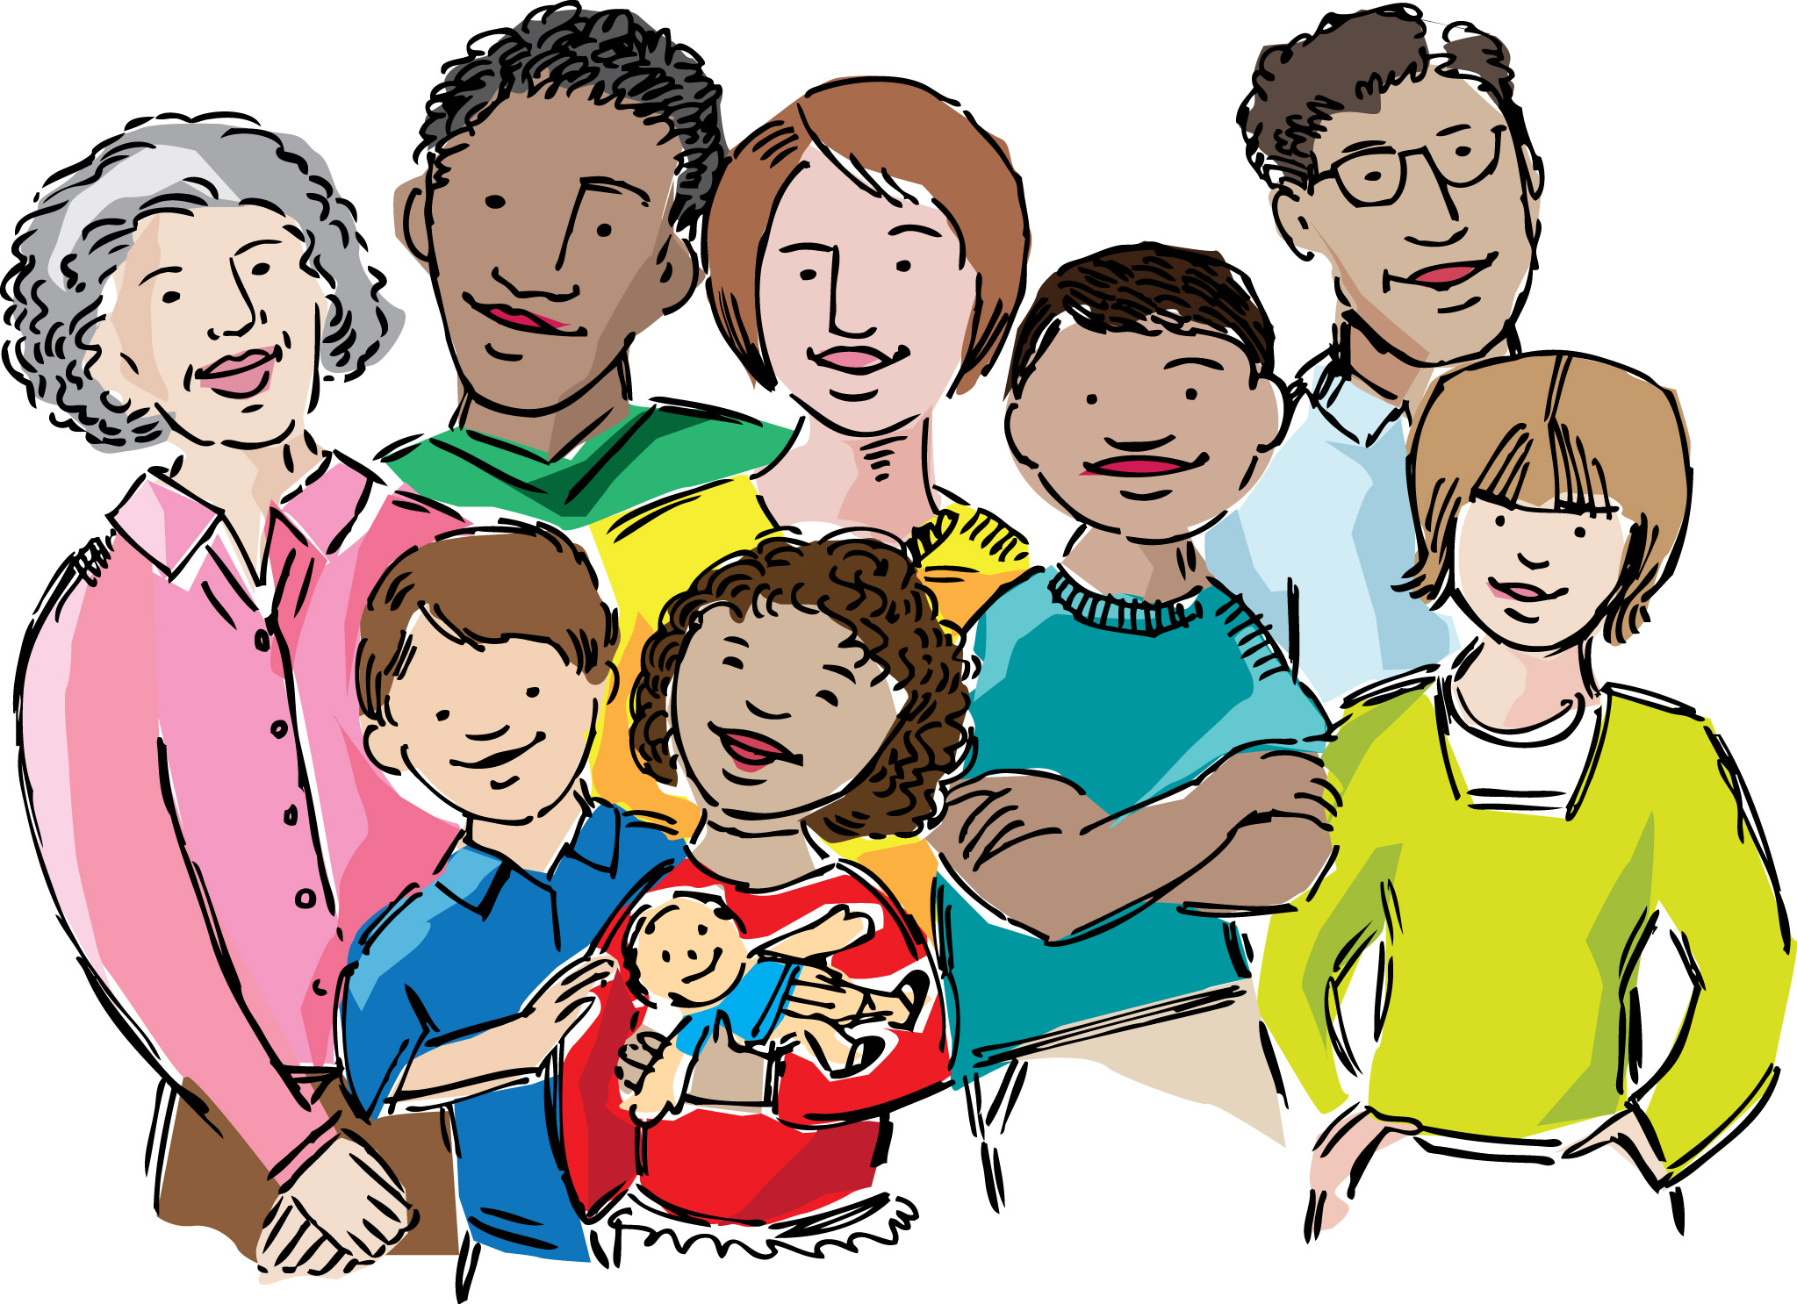
The benefits of belonging
Those who are engaged in their parish:
Are dramatically more likely to be satisfied with the circumstances of their lives.
In other words, they are happier!
Notes:
The Gallup research on engagement demonstrates that when people have a deep sense of belonging within their parish, they are more likely to be spiritually committed.
That spiritual commitment is lived out in inviting others to things at the parish, serving in the parish and the wider community, giving of their financial resources, and being satisfied with the circumstances of their lives, no matter what those circumstances might be.
We who are deeply connected to our parish know the importance of being rooted in our community – it changes the way we live our faith and our faith shapes our lives as a result.
For more on this timely topic, read Turning Hearts to Christ (Anslinger, Twenty-Third Publications, at www.CatholicLifeandFaith.com) or Growing an Engaged Church (Winseman, Gallup Press, 2006)

Slide 5
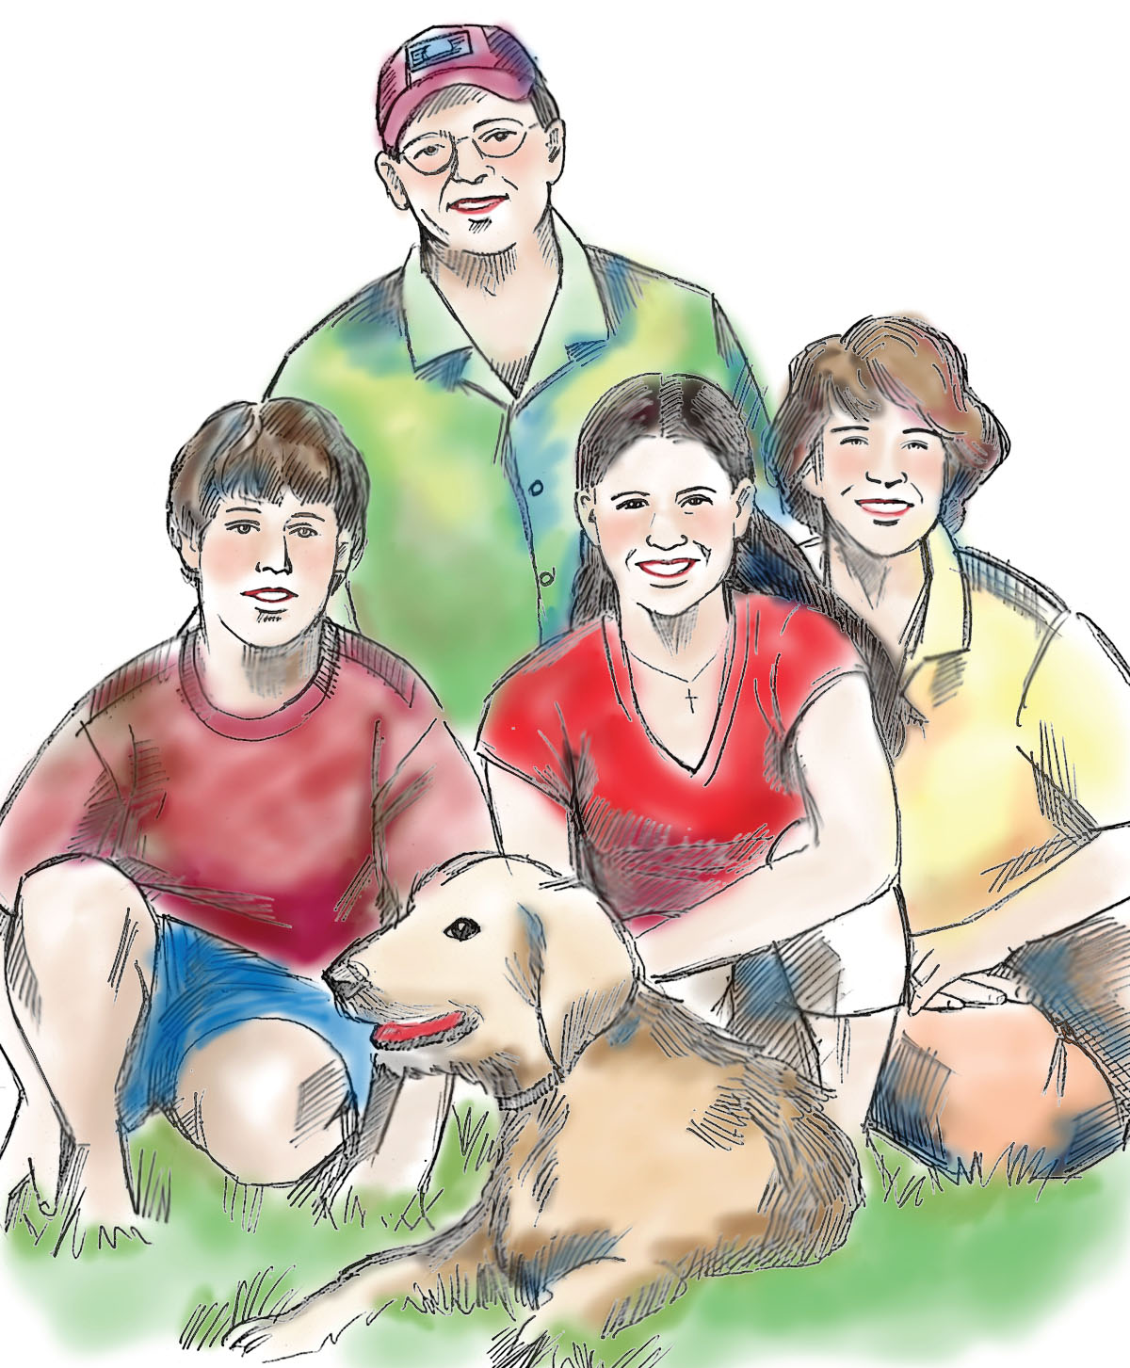
So what’s a father or mother to do?
Fall in love with Christ;
Develop a regular rhythm of participation in Mass and in the life of your parish!
Notes:
If you have not already done so, this is a time to commend those who are present.
Tell them you know you’re “preaching to the choir,” but it is important for them to know how the way they live their lives of faith shapes the way their children are growing as people of faith.

Slide 6
The National Study of Youth and Religion
“Contrary to popular misguided cultural stereotypes and frequent parental misperceptions, we believe that the evidence clearly shows that the single most important social influence on the religious and spiritual lives of adolescents is their parents.”
(Soul Searching: the Religious and Spiritual Lives of American Teenagers, p. 261)
Notes:
Parents and catechists often have a feeling that older children and teens do not want adults in their lives, but the National Study of Youth and Religion and conversations with teens helps us to know this is very much not the case. Older children and teens do want caring adults in their lives, and they are inspired by those who genuinely live their faith at home, in their workplace, and in their local community and world. The balance, of course, is to not hover or preach, but rather to let our lives be our witness. Helping young people to feel that they belong with us and have much to contribute with us to our parish and world will help them grow into spiritually committed young adults.

Slide 7
The National Directory for Catechesis
“The family is defined as a ‘domestic Church,’ that is, in every Christian family the different aspects and functions of the life of the entire Church may be reflected: mission; catechesis; witness; prayer, etc.” …

Slide 8
The National Directory for Catechesis
“It is, indeed, a Christian education more witnessed to than taught, more occasional than systematic, more ongoing and daily than structured into periods.” (NDC, 255)
Or in the words of a wise catechetical leader, “faith is more caught than taught!”
Notes:
On the next three slides, be prepared to offer a story or two to illustrate the impact of living faith at home with your own family or those you are close to.
Or, invite a few parents to prepare a brief witness to the impact of living faith with their family. Invite them to prepare by answering these questions and bringing their prepared reflection with them:
I (or we) realized we needed to live our faith at home when:
I (or we) were most (describe feeling here – hesitant, frightened, worried, uncertain, etc.) about:
What we did was:
What happened as a result:

Slide 9
Let’s keep it simple
Pray together!
Sunday Mass
Seasonal Prayer
At home
Let your children know the importance of prayer in your life
Play together!
Faith Community

Slide 10
Let’s keep it simple
Talk with each other
Apply Church teaching and belief to everyday situations
Ask your children what they think, where their challenges are, what they dream of
Continue to grow
Notes:
Invite participants to share with each other the things they do to reinforce faith and to pray together at home.
Have newsprint ready to record their examples. If you already have a regular time for parents or families to gather for catechesis, this gathering could be included in one of those events; invite the families to bring examples to share with each other.

Slide 11
What do you remember?
How did you come to faith in Christ, or grow in faith over time?
Did your family pray together? Attend Mass together?
Were there family or neighborhood holy day celebrations? Feasts or seasons of the Church year (Advent, Christmas, Epiphany, Lent, Easter, Pentecost, May Crowning, etc.)
How did you learn to pray, acquire basic beliefs, or develop skills in faith-influenced decision-making?
Are you still learning and growing in faith?

Slide 12
Who has most influenced you?
Who helped you to develop faith in Christ?
Who encourages you to live as a faith-filled Christian now?
What about that person is most compelling or inspiring?
For whom are you called to be such a witness?
Notes:
This is a great way to invite participants to recognize the people in their lives who support and encourage them, and to think about those who rely on their encouragement and witness.
It is also a wonderful transition to the closing of this presentation, in which you can share future opportunities that are planned, or to ask for help in designing such opportunities.

Slide 13
Here are some concrete things you can do in the coming months to act on what we have discussed together:
Notes:
Echo some of the ideas that have been shared in this gathering, and add to the slide upcoming family or adult faith formation opportunities, resources, or upcoming parish events.

