Slide 1
Write down the Vision
clearly upon the tablets
so that one can read it
readily.
For the Vision
still has it’s time,
presses on to fulfillment,
and will not disappoint.
If it delays,
wait for it.
Habakkuk 2:3
Notes:
1

Slide 2
THE CONFIRMATION PREP PROJECT
A project of the
National Initiative on Adolescent Catechesis

Slide 3
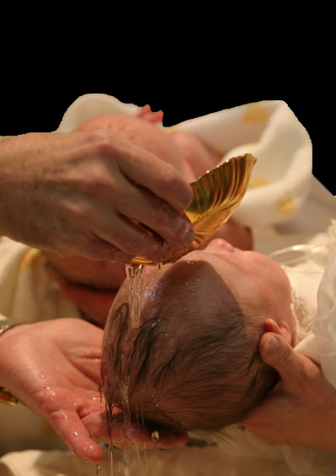
“ratification of Baptism, thus completing Christian initiation, and the strengthening of baptismal grace” CCC1289
“the completion of baptismal grace” CCC1285,1303,1303
CONFIRMATION

Slide 4
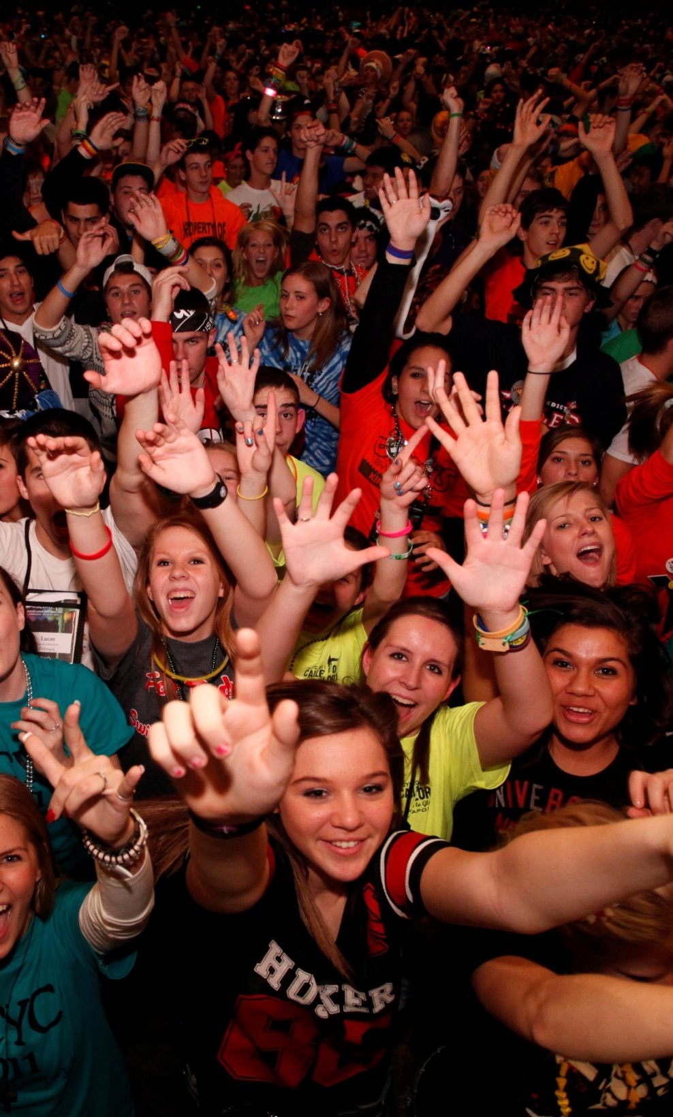
How can we enhance Confirmation prep’s ability to be a more formative
experience in the lives of
young people?
583,000 Confirmed in 2013
UNCHAINING CONFIRMATION

Slide 5
What kind of experience
did they
have?
EVALUATIVE QUESTION

Slide 6
Potential enhancements to Conf Prep
Enhance the FOCUS
1. Increased sensitivity to the Spirit
2. Articulate experiences of grace, nature of their faith, grasp of the Tradition
3. Challenging moral and theological examination
4. Evaluation and ownership of their Catholic Identity
Enhance the PROCESS
1.Spiritual Growth Plan
2.Some formational work on their own
3.Mentoring
INTENTIONALLY
Teaching For Discipleship

Slide 7
1. Suppose we help them to develop spiritual sensitivities and awakenings?
“The maker of Heaven and earth,
of all things
VISIBLE
and
INVISIBLE.”
Enhance the focus

Slide 8
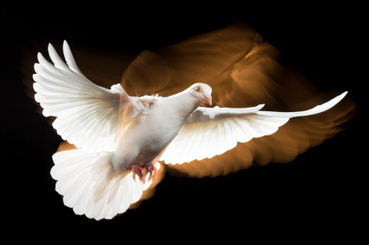
…should aim at leading the Christian toward a more intimate union with Christ and a more lively familiarity with the Holy Spirit—his actions, his gifts, his biddings —in order to become more capable of assuming the apostolic responsibilities of Christian life.” CCC 1309
PREPARATION FOR CONFIRMATION

Slide 9
“The world is crowded with God.
The real labor is to remember,
to attend.
In fact,
to come awake.
Still more.
To remain awake.”
C.S. Lewis
AWAKENINGS

Slide 10
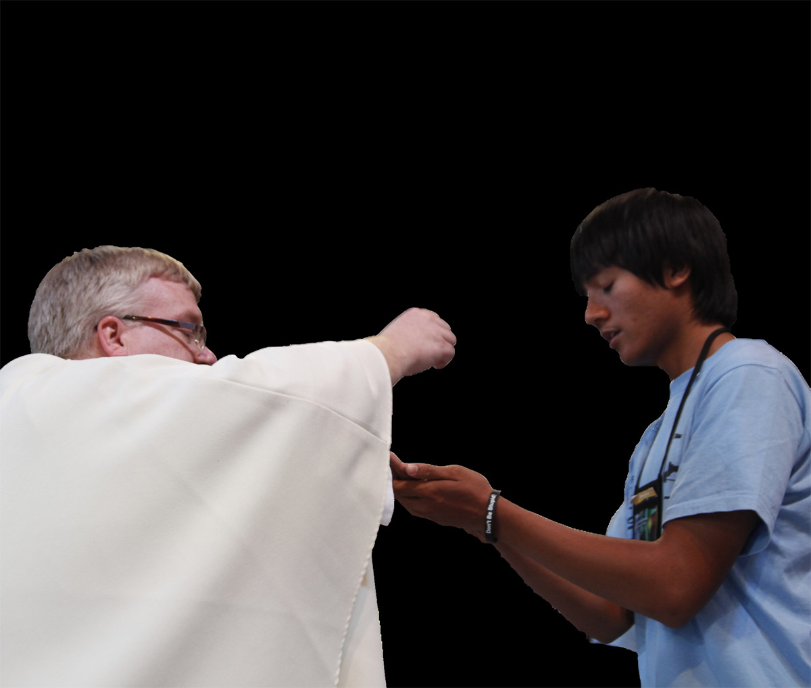
2. Suppose we help them
evaluate and own
the nature of their Catholic Identity?
Enhance the focus

Slide 11
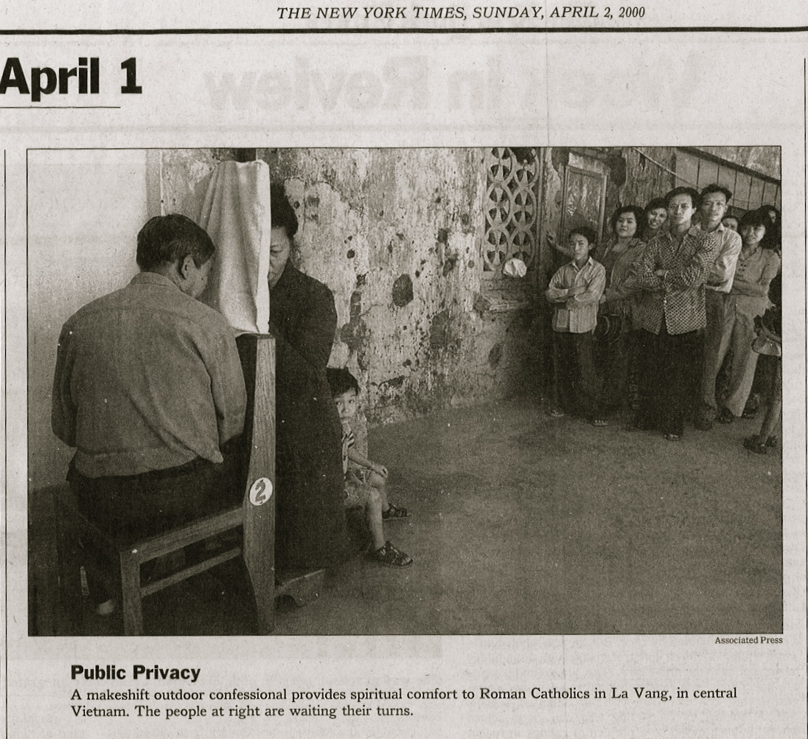

Slide 12
3. Suppose we helped them imagine the call and practices of discipleship?
I stand at the door and knock…
Enhance the focus

Slide 13
Can someone be a believer but not a disciple?
A disciple is different than a believer. How?
REDISCOVER THE
“TRADITION OF THE CALLING” D. SCHON

Slide 14
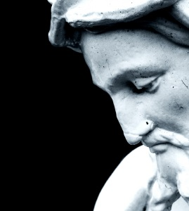
STUDIES the ways of the One
and
LIVES by them
DISCIPLE

Slide 15
Discipleship
for the good of the World
within a Community of Disciples
and the will of God.
LIFE AFTER CONFIRMATION

Slide 16
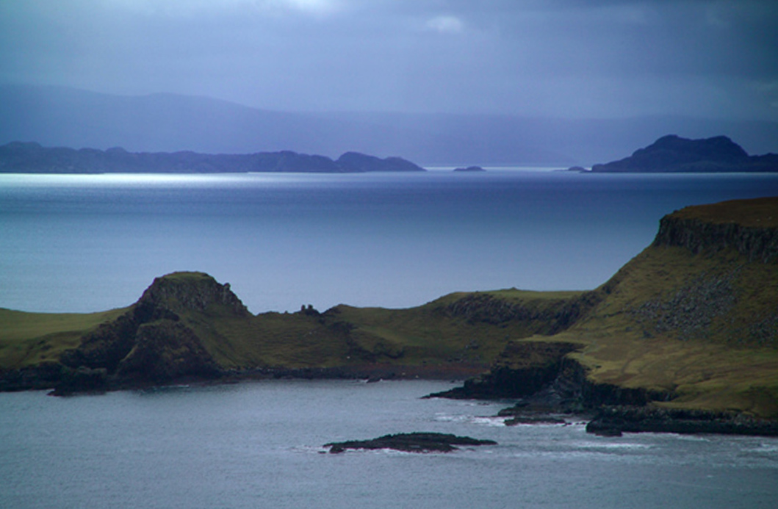
Putting and end to Confirmation as The End
Life after Confirmation
Discipleship …
within a Community of Disciples…
for the good of the World
and the glory of God.
Notes:
16

Slide 17
4. Suppose we engaged in meeting them where they are…
And driving them out of their minds …
For a minute?
Enhance the focus

Slide 18
so they can consider:
The mind of Others
The mind of Christ
The mind of the Church
Challenging Moral
and
Theological reflection
Enhance the focus

Slide 19
5. Suppose we help them to develop
The skills
and the language
to articulate
the nature of their faith…
their experiences of grace…
Enhance the focus

Slide 20
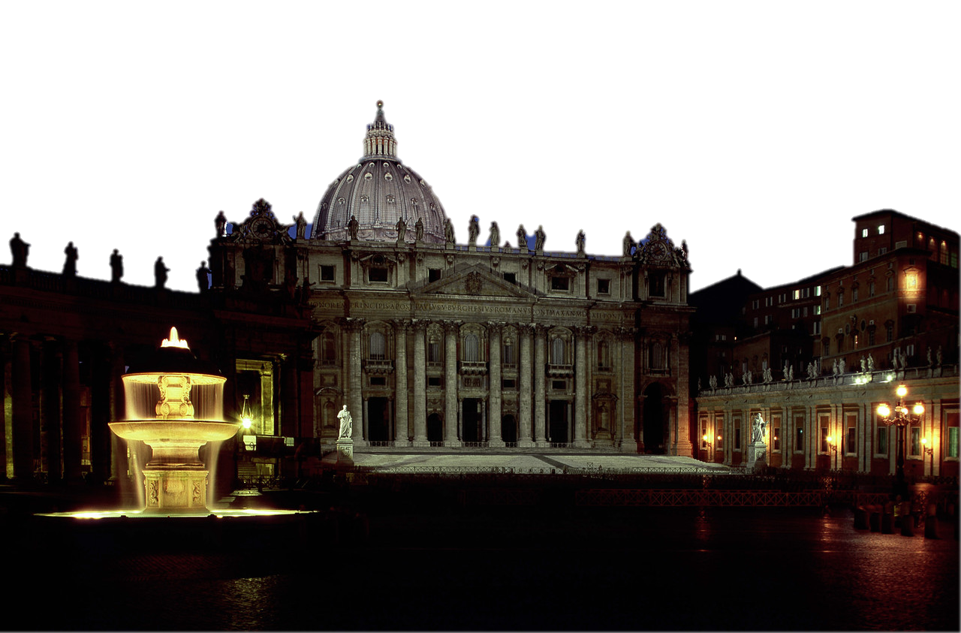
…and their grasp of Tradition

Slide 21
6. Suppose we asked them to develop a
Spiritual Growth Plan?
Knowledge?
Horizontal?
Spiritual Growth
Attitudes?
Vertical?
Behaviors?
Internal?
Enhance the process
Notes:
21

Slide 22
30 Day s = 60 minutes
1 Day = 2 minutes
(16hrs)
8 Hours = 1 minute
IF A MONTH WAS AN HOUR

Slide 23
How do you want to spend your minute?
NEW CATECHETICAL QUESTION

Slide 24
How can we help them
use some of their 59 minutes?
NEW CATECHETICAL QUESTION

Slide 25
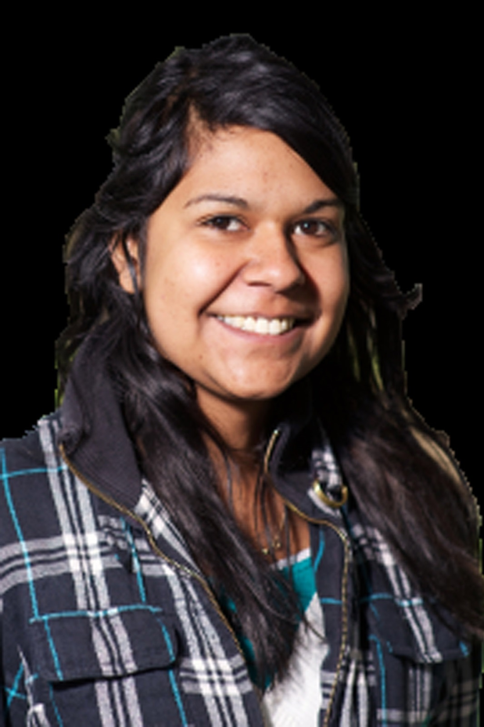
7. What we can help them to do on their own…
but not alone?
Invest in the adolescent isolate.
R. Dykstra
Enhance the process

Slide 26
Small group leaders
Co-sponsors
On site Service organizers
Post retreat follow-up
Parish supporters
8. MENTORING ENVIRONMENT
Enhance the process

Slide 27
Which enhancement interests you most?
Increased Spiritual sensitivities
Evaluate and own their Catholic identity
The Call and Practices of discipleship
Challenging moral and theological engagement
Articulation of faith, grace, and Tradition
Forming a Spiritual Growth Plan
Some formation on their own, but not alone
a Mentoring environment
WHAT KIND OF EXPERIENCE
WILL THEY HAVE?

Slide 28
Challenges facing our Confirmation prep program
TEAM THEME
TOOL(s) TECHNIQUE(s)

Slide 29
Inductive: Life Faith Response
Deductive: Faith Life Response
This dialogue between faith and life is
“the profound drama of our time.” (Pope Paul VI)
“Faith that does not connect to life is dead.
Life that is not illuminated by faith is blind.”
(Cardinal Ratzinger, 1983)
Inductive and Deductive Methodology

Slide 30
The catechist is essentially a mediator and a knowledgeable disciple, engaging young people
through a variety of methods , activities, and learning approaches, including the use of media, music, memorization, group dynamics, liturgy and
prayer.
Helping young people read their experiences along with the questions and needs raised in light of the Gospel.
Offering them a spiritually challenging vision that helps young people meet their hunger to participate in the noble adventure of discipleship.
(GDC 3152-156, NDC p.201,202,224)

Slide 31
Spiritual sensitivities/ awakenings
Evaluated Catholic identity
Call to the practices of discipleship
Moral and theological engagement
Articulation of faith, grace, and Tradition
Spiritual growth plan
On their own, but not alone
Mentoring environment
WHAT KIND OF EXPERIENCE
DID THEY HAVE?

Slide 32
Write down the Vision
clearly upon the tablets
so that one can read it
readily.
For the Vision
still has it’s time,
presses on to fulfillment,
and will not disappoint.
If it delays,
wait for it.
Habakkuk 2:3
Notes:
32

